Slide 1
ANML FARM
Pitch Deck
3 November 2025

Slide 2


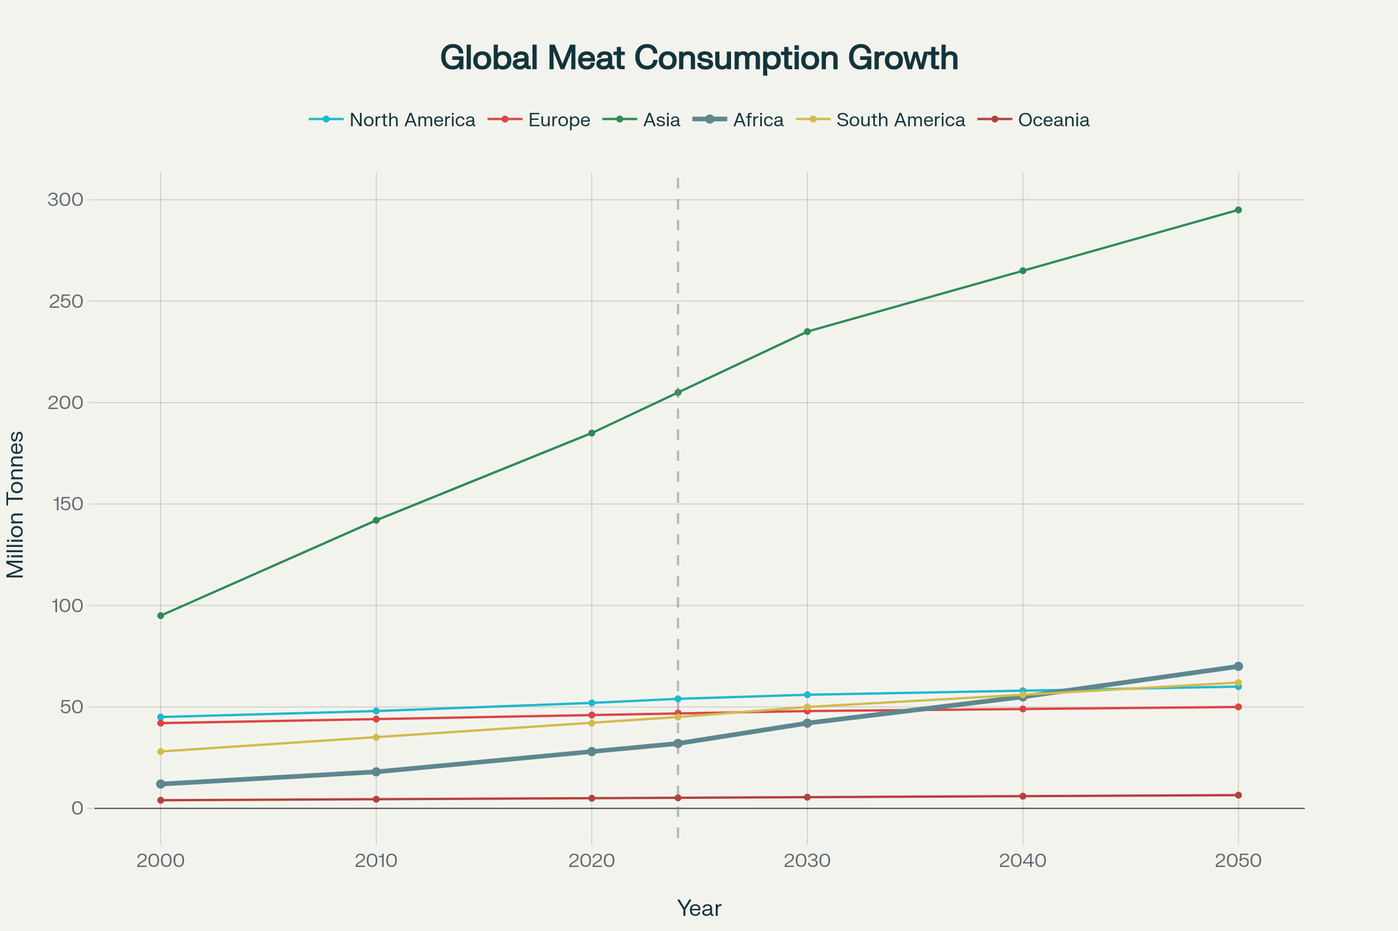
ANML FARM seeks to aid African farmers in crisis by providing accessible technology, services, and products that increase productivity, profit and safety
Problem Statement
Name Johannes
Farm: 200 cattle @ 500ha
Revenue: R800kpa
Goals
To reduce cost and increase revenue while keeping his family and animals safe
Challenges
Theft anxiety
24/7 security concerns, sleepless nights worrying about livestock safety
Impact: R50,000+ annual losses.
Employee Issues
CCMA compliance challenges, labor disputes, performance management
Impact: R30,000+ legal costs
Manual Systems
Excel spreadsheets and paper-based records, time-consuming and error-prone
Impact: 10+ hours weekly on admin
Limited Support
Isolated from technical support, delayed veterinary care, poor market information
Impact: 15% lower productivity
African farmers also need help to capture a market set to grow 119% by 2030
South Africa's Livestock Potential: With 14 million cattle and 70% of agricultural land suitable for livestock, South Africa has substantial untapped potential. However, productivity remains low with communal farmers controlling 40-50% of the national herd but achieving less than 35% calving rates versus a potential 50%
A
Supply gap: local production not meeting demand growth
E
Market fragmentation: disconnected value chains from farm to table
B
Infrastructure: Poor connectivity and services in rural areas
D
Technology gap: limited adoption of modern farming practices
C
Climate challenges: drought and disease outbreaks affecting productivity
Notes:
Quick wins:
Hackathon
Batch days
Creation of referral program
Long-term initiatives:

Slide 3
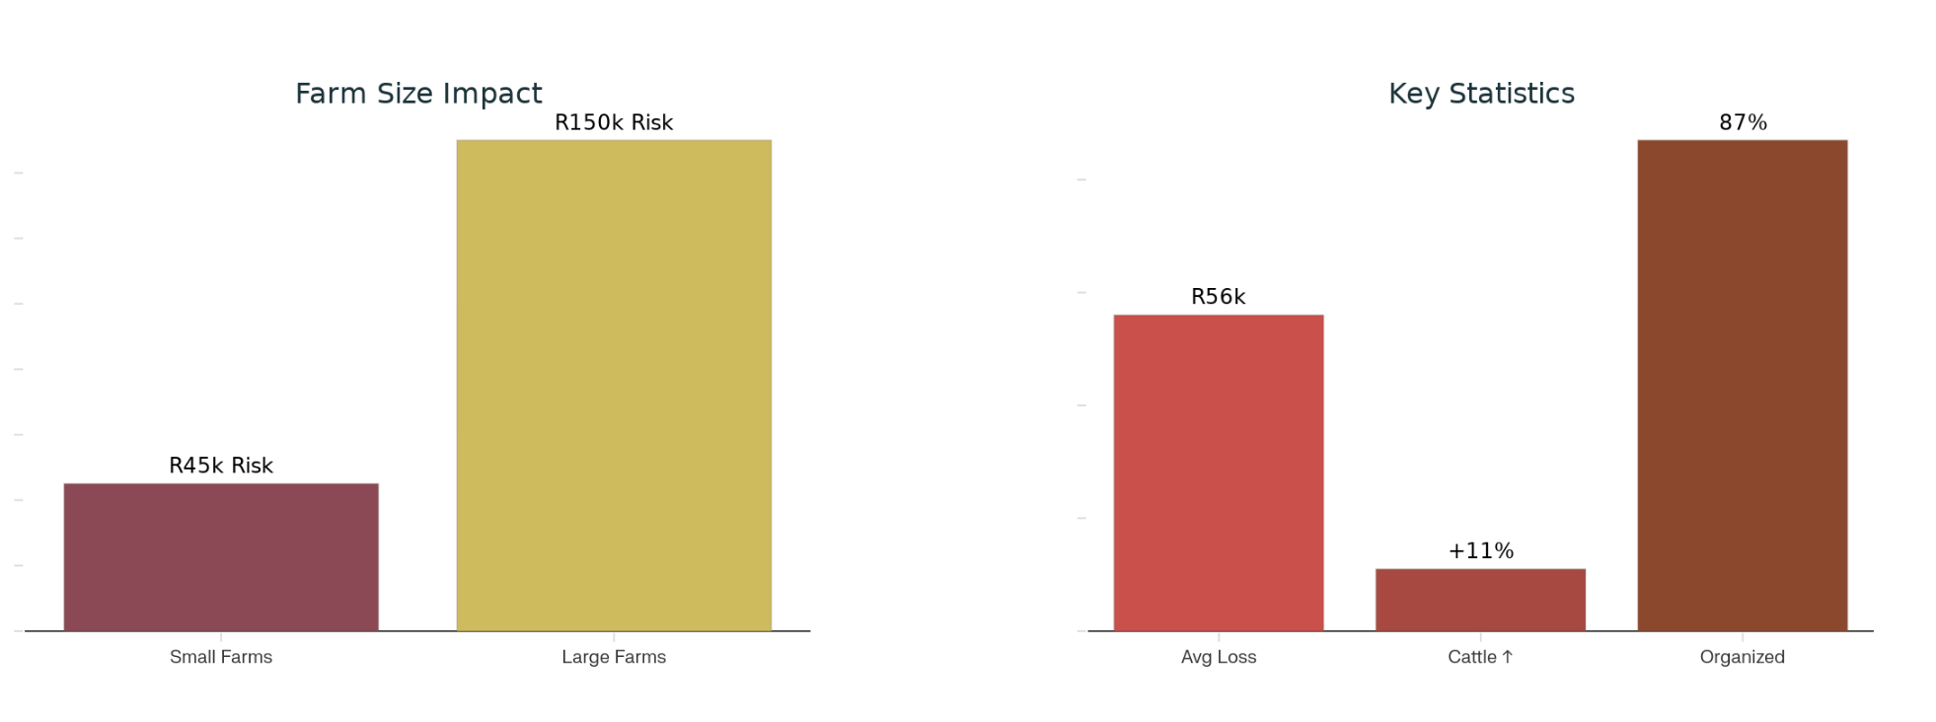




Our interviews with farmers highlighted key challenges at the root of the crisis
Both internal and external factors keep farmer growth at lower levels
A. Management challenges
B. Theft crisis
1
2
Employees Complex labor law compliance creates CCMA risks for farmers
Data access Poor record-keeping systems (mostly Excel and paper-based)
R1.4 billion annual economic impact on South Africa's economy
87% of theft involves organized crime syndicates, not just survival theft
Only 25% of livestock crimes are reported to police
Cattle theft increased by 11% in recent quarters
3
4
Coordination and Isolation Poor collective organization - Weak farmer associations - Limited knowledge sharing - Ineffective collective bargaining
Low Productivity Current calving rate vs potential is 35% vs 50% due to: - Poor breeding management - Inadequate nutrition planning - Limited veterinary access

Slide 4

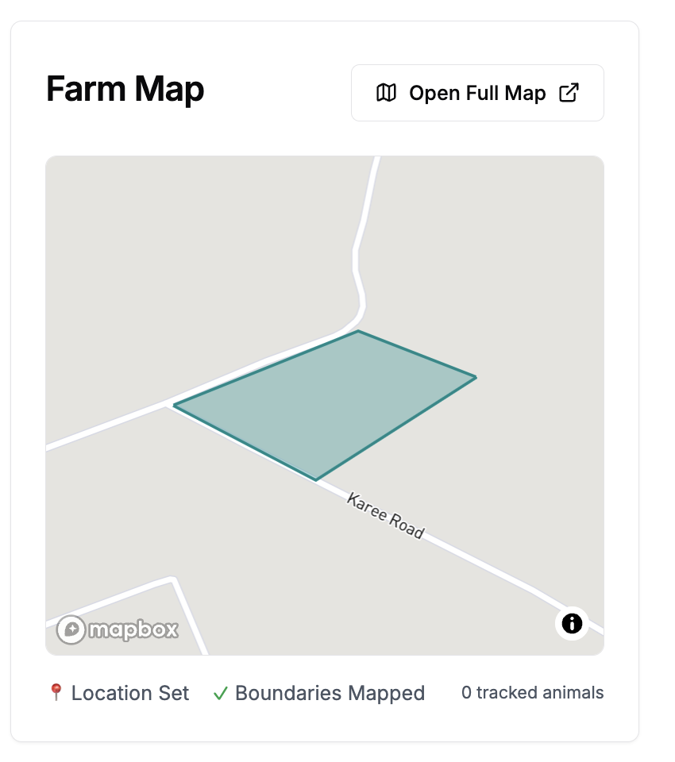
Our Solution: Who We Are
Vision
“Digitize and democratize African livestock farming for global competitiveness”
Mission
“Increase farmer profitability through integrated technology solutions”
Our Story
Founded by Jean Louw and Louw Steenkamp in 2021 with the idea to address prominent gaps in the operations of every-day farmers.
With combined knowledge of farming and technology and decades of experience solving problems for corporate clients, building a good business was inevitable.
Now we are 4 years in and ready for our second steps into the market.
Innovation: Cutting edge IoT and AI solutions
Partnership: Collaborative ecosystem approach
Sustainability: Long-term farm viability focus
Empowerment: Farmer-centric solution design

Slide 5
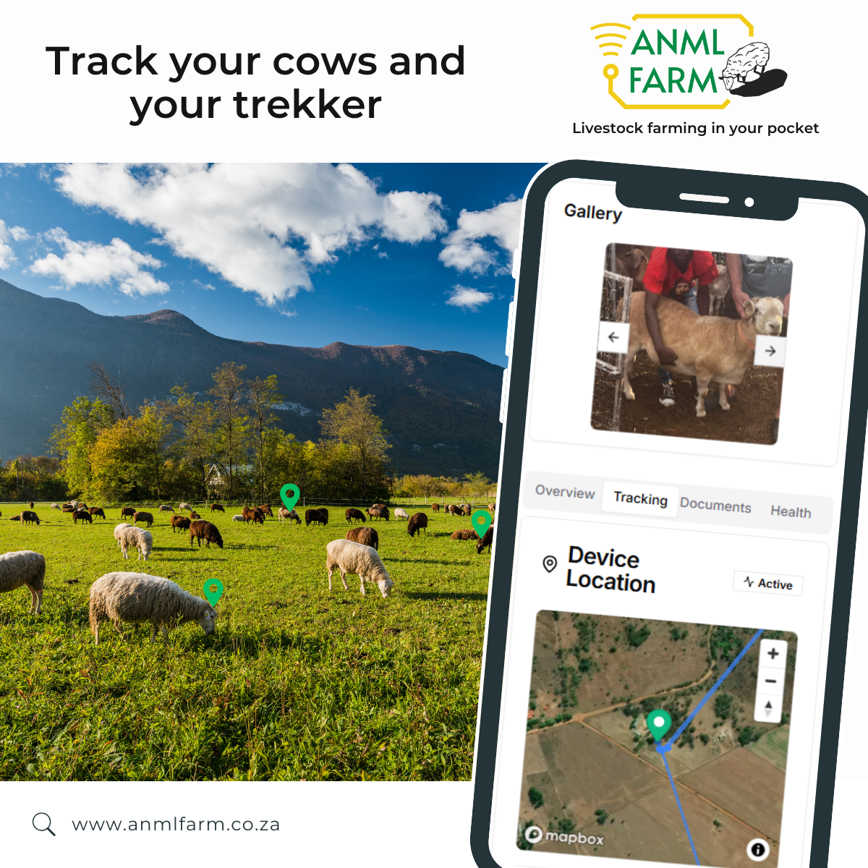
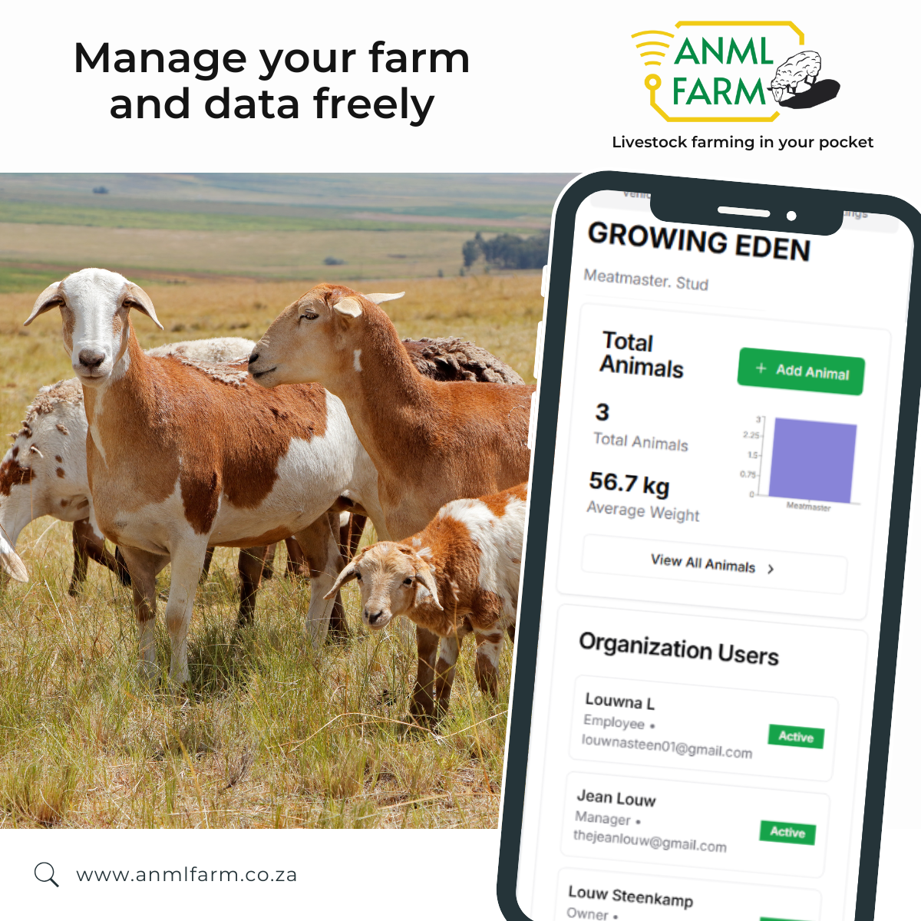
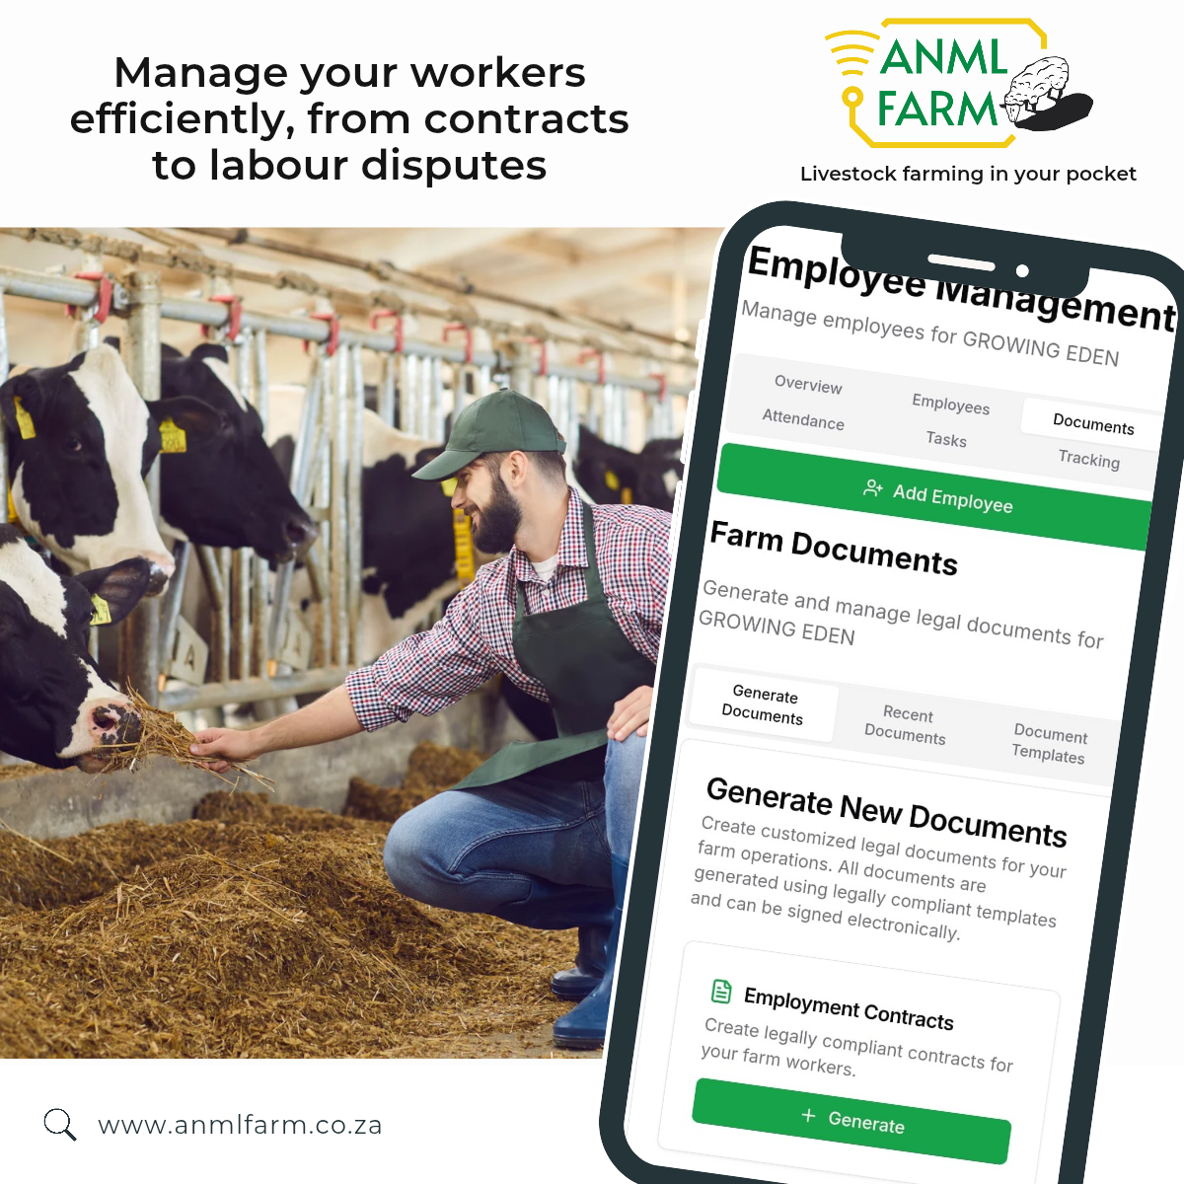
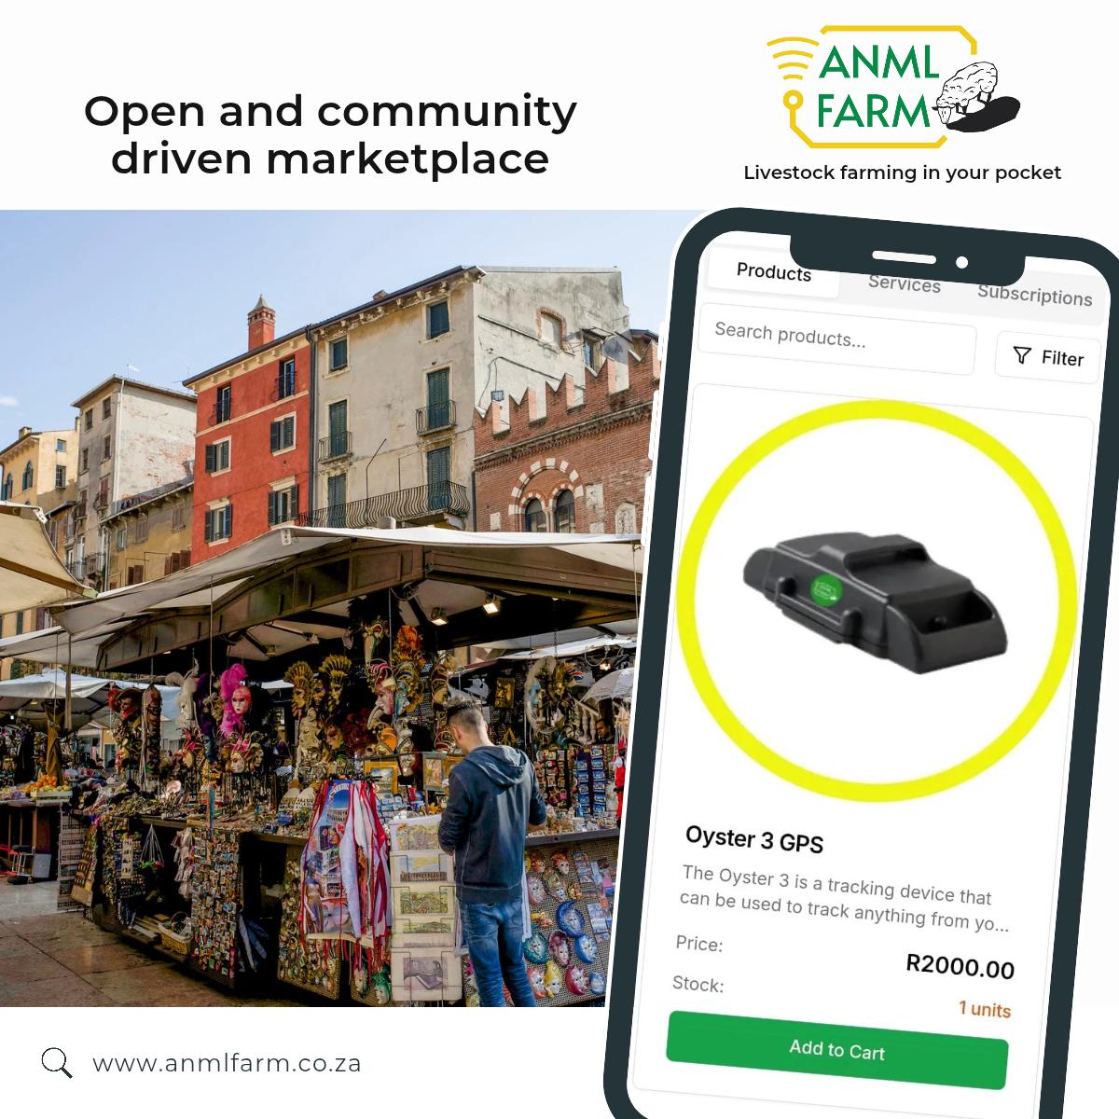
What we offer
IoT Asset Tracking
Farm & Data Management
Labor Management
Integrated Marketplace
Real-time GPS monitoring of cattle, vehicles and worker location and movement
24/7 theft prevention alerts
Bluetooth sensors and monitoring
Automated record keeping
Centralized data management for animal, personnel, and assets
Growth and health tracking
Heritage and production
Statistics and reporting
Easy-to-share links and QR codes
Employee compliance and optimization systems
CCMA compliance automation and services
Performance and task tracking
Legal representation support
Direct market access and trading platform
Buyer-seller matching
Quotation and customer management
Stock and product visibility
Transaction and delivery facilitation

Slide 6






ANML FARM aims to affect systemic change in social, environmental, and economic terms through democratized technology and service delivery
Every farmer using ANML FARM creates ripple effects across 6 Sustainable Development Goals (SDGs)
Impacted SGD Goals
SGD 1.4: No Poverty We provide equal access to economic resources and technology, targeting all mobile and computer platforms to enable:
Reduced losses from theft
New revenue streams via marketplace
Increased productivity and ROI
SGD 2.3: Zero Hunger We provide up to double productivity for small scale farmers through precision farming techniques:
productivity improvement through data-driven decisions
Improve calving rates
Better breeding management and nutrition planning
SGD 8.3: Decent Work We provide the means of formalization and growth for our primary SME market:
Formalize farm employment with digital contracts
Performance tracking creates accountability
Enable farmers to scale and create jobs
SGD 12.2: Responsible Production We provide a platform to track sustainable management and efficient use of natural resources:
Data-driven grazing and resource optimization
Reduce waste through better inventory management
Track and improve feed efficiency
SGD 13.2: Climate Action We provide data and feedback to integrate climate measures into policies and planning:
Increase productivity = fewer animals for same output = lower emissions per kg
Weather integration for climate adaptation
Resilient farming practices through analytics
SGD 15.1: Life on Land We provide the means of conservation and restoration of terrestrial ecosystem:
Geo-fencing prevents overgrazing
Track and optimize land use
Genetic diversity preservation through heritage tracking
Sustainable rangeland management

Slide 7

ANML FARM needs to scale intelligently to capture value in a growing market
Market opportunity
Market Gaps
Competitive advantages
Precision Livestock Monitoring
This is the fastest-growing segment in agritech globally.
South Africa: $130.8M (2024) → $314.3M (2033) at 11.6% CAGR
Global Scale: $7.5B (2024) → $19.89B (2033) at 9.7% CAGR
Integration Gap
Tracking companies offer only GPS. Data management tools ignore theft
Marketplaces ignore compliance. Insurance requires manual workarounds.
Integration Moat
Competitors: Point solutions (tracking OR management OR marketplace OR compliance)
ANML FARM: Single ecosystem where each module enhances all others
Livestock E-Commerce & Marketplace
Africa's meat demand is outpacing supply, and the shift from traditional sources to digital direct-to-consumer is accelerating
Global Agricultural E-Commerce: $18.4B (2024) → $45B (2035) at 8.4% CAGR
African Context Gap
AgriWebb, FarmLogs, and Farmbrite are priced for developed markets (USD 50-200/month). They assume stable connectivity and cloud-only access. They're crop-focused, not livestock-centric
Farmer-Centric Design
Competitors: Designed by engineers in urban offices without field validation
ANML FARM: Every feature tested with real farmers. Mobile-first. Works offline. Culturally appropriate.
Livestock Insurance Market Surge
Climate change, disease outbreaks (FMD recent), and price volatility are driving demand for livestock insurance
South Africa: $53.9M (2023) → $91.3M (2030) at 7.8% CAGR
Global Market: $16.5B (2023) → $35.8B (2033) at 8.1% CAGR
Data Accessibility Gap
Insurance companies have no real-time animal health or location data.
Breed registry companies see only genetics, not productivity. Marketplace buyers have no traceability information.
Data Moat
Competitors: Individual farm data silos
ANML FARM: Aggregated anonymized data on livestock across SA. Enables benchmarking, predictive analytics, risk assessment that competitors can't match
Notes:
Quick wins:
Hackathon
Batch days
Creation of referral program
Long-term initiatives:

Slide 8
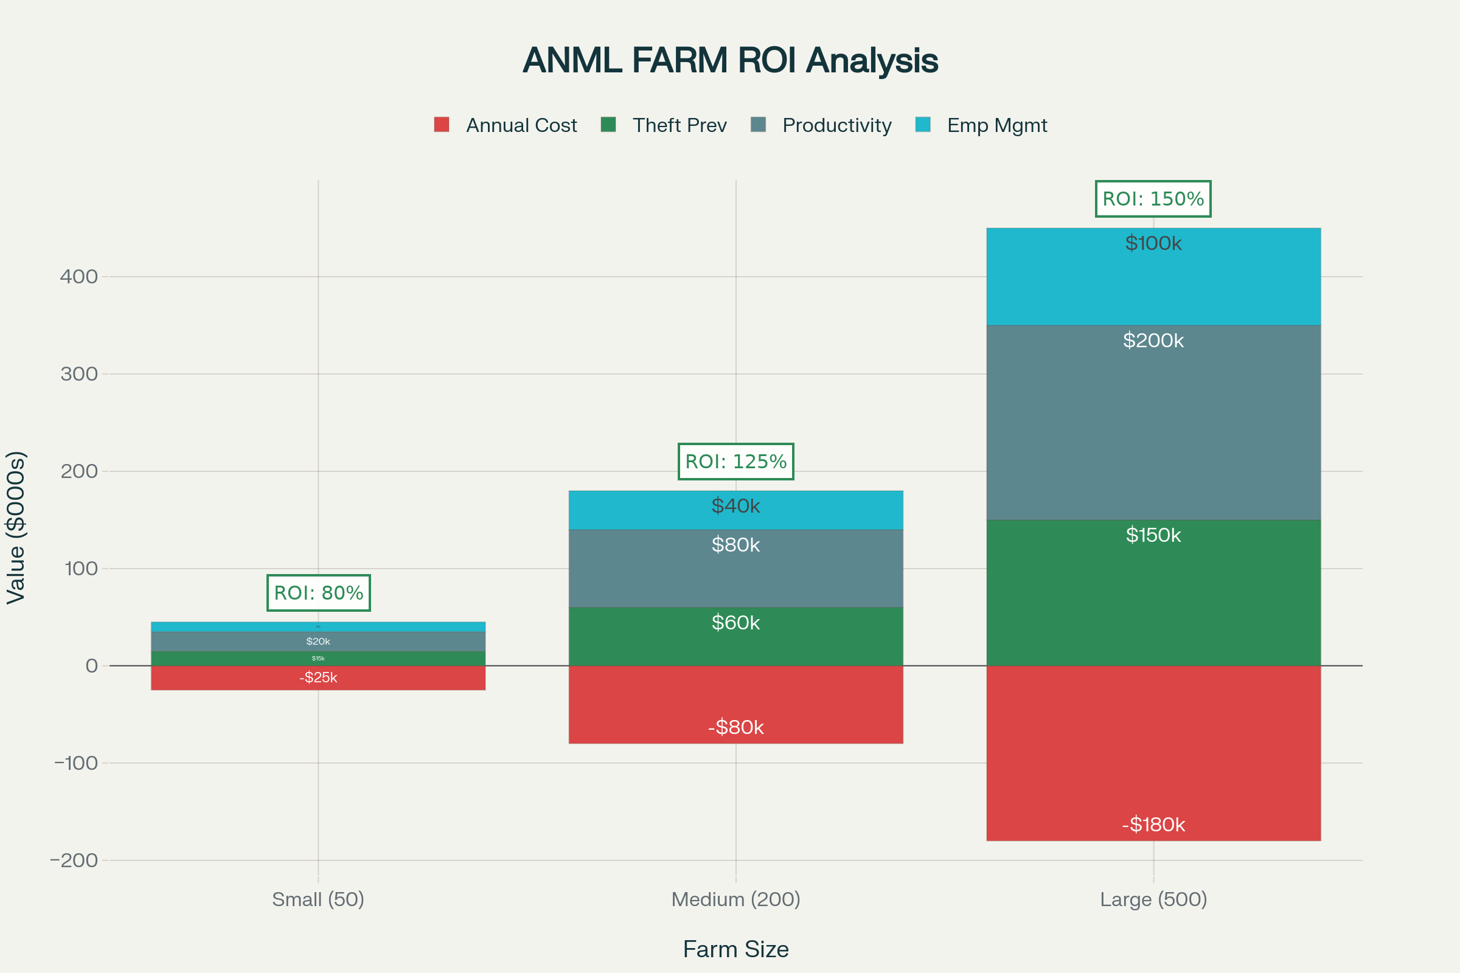
How we capture value through network effects
As more farmers join our platform, the value for all participants increases exponentially through data insights, market liquidity, and ecosystem partnerships.
A. Recurring Revenue Streams
B. Providing ROI to R12B livestock market
1
2
SaaS Subscriptions Monthly platform fees per farmer
R100 – R1000 per month*
Transaction Fees Marketplace commission on sales
2-5% per sale
3
4
Data Services Analytics for partners & insurers
R100– R1000 per month*
Partnership revenue Revenue sharing with ecosystem partners
10% - 30% share
Consistent average of 142% ROI across all farm sizes with breeding efficiency as primary value driver
1 Subject to farm- or partner-specific requirements

Slide 9
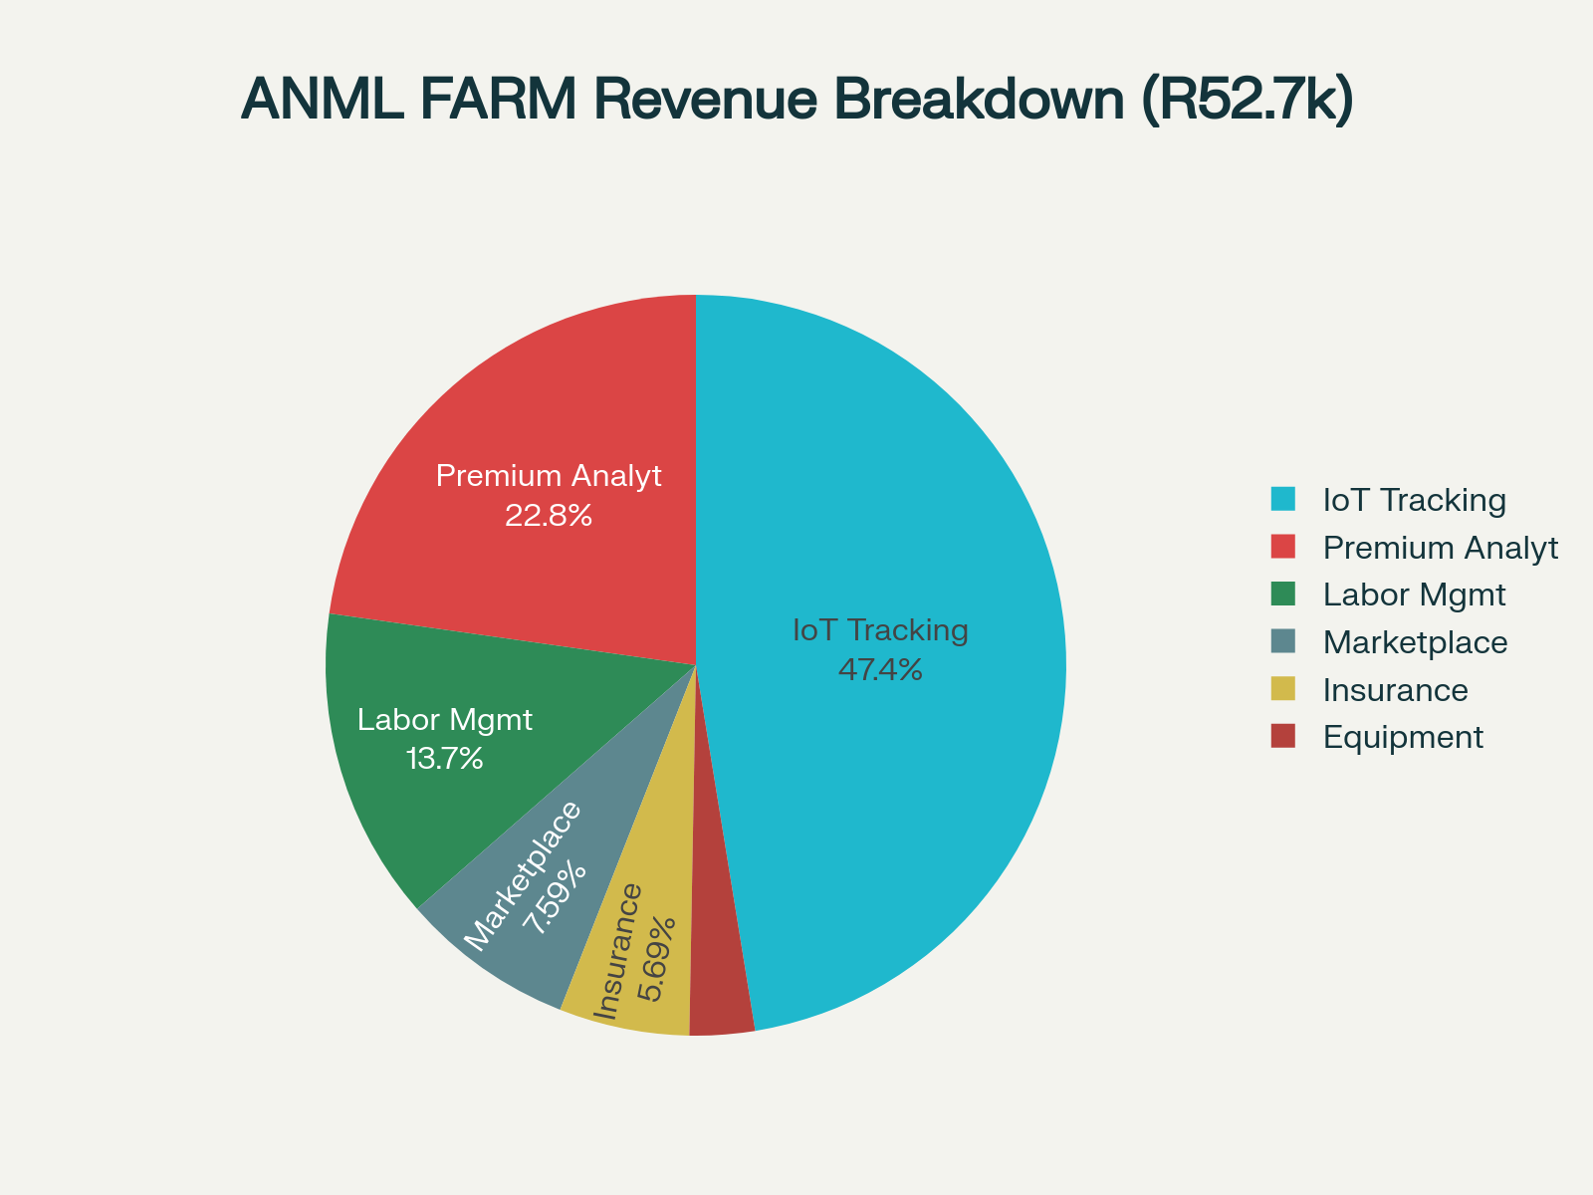
Financial Model Key insights
Break-Even & Profitability Timeline:
Q1 2026: Break-even achieved at 200 farmers
Q3 2026: Strong margins emerge at 500 farmers
Q4 2027: Premium profitability at 10,000 farmers
Funding Strategy Aligned with Growth:
Seed Round (R5M): Early Bird program and product-market fit
Series A (R25M): Regional scale and partnership ecosystem
Series B (R100M): Continental expansion and market leadership
Exit Potential:
2027 Valuation: R2-5 billion (8-20x revenue multiple)
Annual Profit: R87 million with 34.8% margins
Market Position: Regional leader with international expansion ready
Revenue projections give insight on where efforts should be directed

Slide 10





We are following a standard approach for market readiness
Created the MVP product with in-field testing
Created the MLP website from feedback from MVP phase
Built to scale and ready for customers
Build For Success
Considerations for a successful launch:
Carefully select early adopters
Progressive technology mindset
100+ animals
Commitment to feedback
Early Bird Program
Product readiness % performance
Partnership agreements with integrations
Strong portfolio of onboarded farmers
Marketing and acquisition channels
Operations and team readiness
Carefully select and approach ecosystem partner
Develop custom services and integrations
Build agreements and SLA’s
Partnership Outreach
Prepare employees and resources
Prepare content and marketing strategy
Invite farmers and media
Launch with a bang
Live Launch

Slide 11
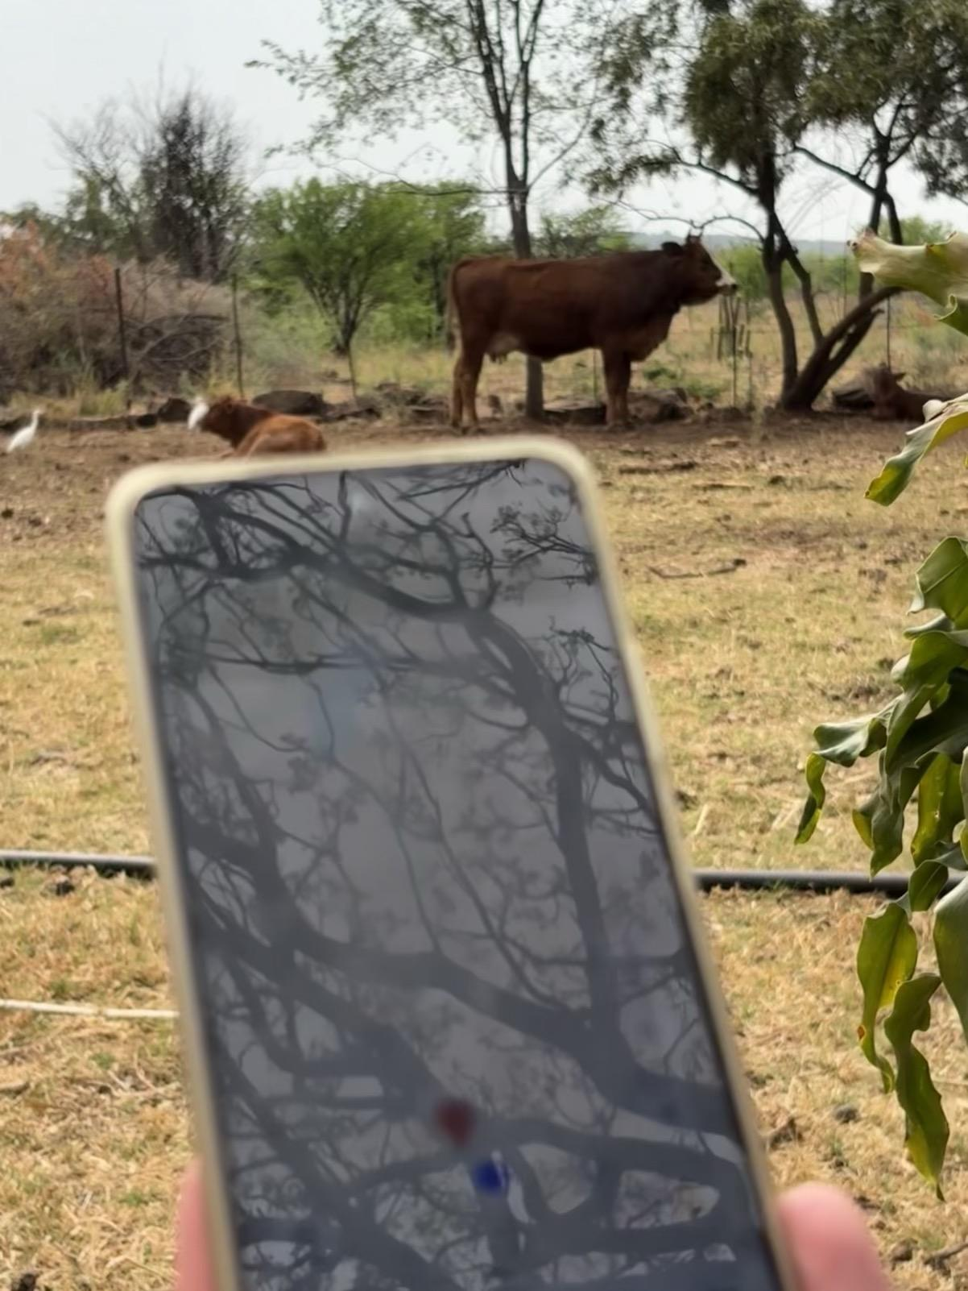
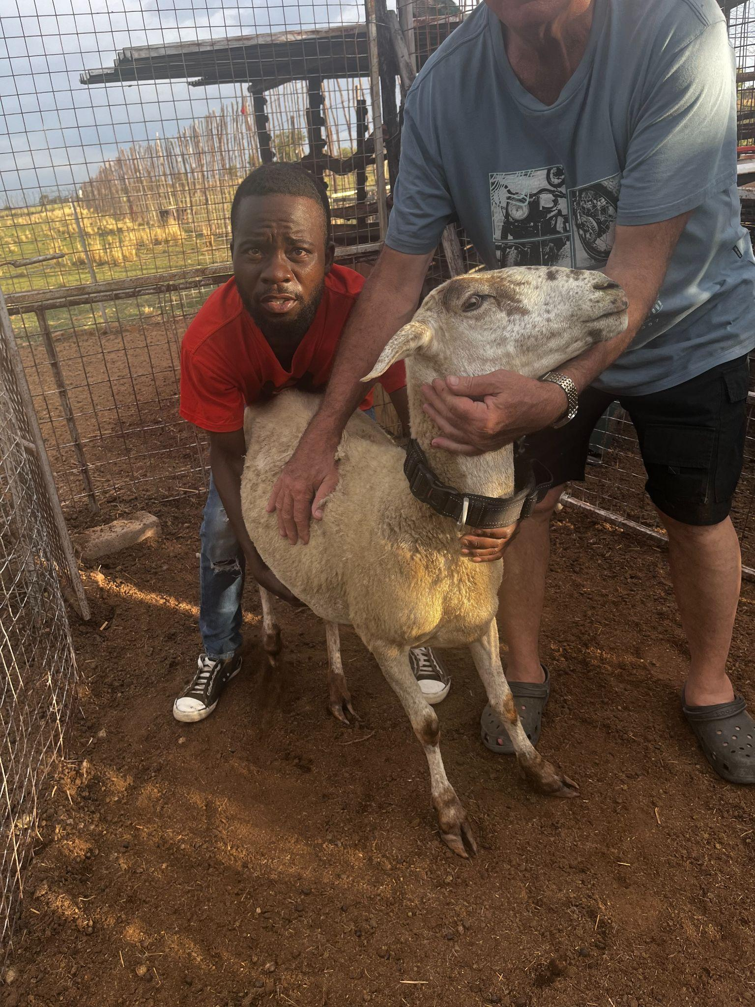
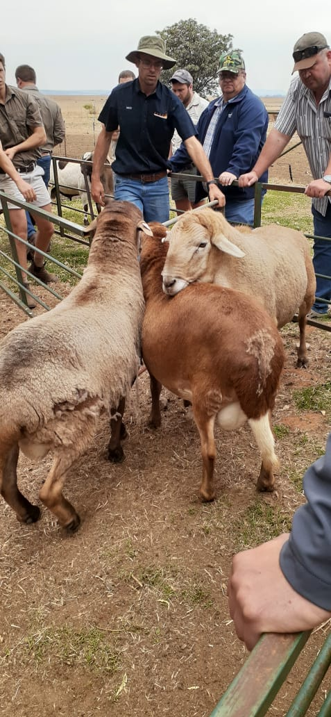
ANML FARM has activated 5 Early Bird adopters since October to test and refine our solutions while we focus on building business partnerships
Customer Acquisition Cost: R2500 - Lifetime Value: R36000 - CAC:LTV @ 14.4:1 (above 3:1 average)
Farmers and Partnerships in place
Perdekop Potchefstroom
Growing Eden
Rayton
Denico
Petronella

Slide 12
We have a clear roadmap to utilize AI to add significant value to the farmer
Q1 2026: Predictive Pricing Intelligence
Q2 2026: Grazing Optimization Assistant
Data Source: Market price feeds (Digikraal, BKB, local markets)
AI: Time-series forecasting → predict optimal selling price/timing
Impact: Farmers maximize revenue; could improve profit by 5-10%
Revenue: R200/month premium feature or transaction fee on marketplace sales
Market Need: Farmers currently sell at market lows; AI timing could add R50-100K+ annually per farm
Data Source: Weather + GPS boundaries + historical grazing patterns
AI: Generate grazing rotation plans + paddock rest recommendations
Impact: Optimize feed efficiency; reduce overgrazing damage; improve animal weight gains by 8-12%
Revenue: R300/month for large farms; revenue from feed companies
Climate Impact: Lower emissions per kg meat
Q3 2026: Insurance Claims Processing (Custom for Insurance Partners)
Q4 2025: Automated Compliance Reporting
Data Source: GPS location at time of theft + health history + farmer reported incident
AI: Analyze claim legitimacy + automate approval for clear cases
Impact: Reduce insurance claim processing time from 14 days to 1-2 days; reduce fraud by 20%+
Revenue: R5-10M+ annually from insurance partner integration fees
Data Source: CCMA templates + employment records + transaction history
AI: Auto-generate audit reports for farm inspections (SABS, health dept)
Impact: Reduce compliance preparation time from 40 hours to 2 hours; eliminate audit penalties
Revenue: R500/month compliance suite premium
Market Need: Farms spend 40+ hours/year on compliance documentation

Slide 13

Invest in ANML FARM and the Future Today
Why We Deserve Capital
1. Proven Traction
✓ 4 years platform development (de-risks technology)
✓ 50 early adopters generating real usage data
✓ 90%+ farmer satisfaction score
✓ 142% average farmer ROI (economically proven)
✓ Platform achieving 99%+ uptime
2. Massive Market with Low Penetration
✓ USD 65B+ addressable market (precision livestock + marketplace)
✓ <2% technology penetration in South Africa
✓ 14M cattle with only 15-25% tech adoption
✓ 119% African meat demand growth by 2030
3. Defensible Competitive Position
✓ First-mover advantage in integrated platform
✓ Data moat (largest livestock database)
✓ Network effects (partnerships + ecosystem)
✓ 5-year farmer relationship advantage
✓ Switching costs increase with each farmer's investment
4. Clear Path to Profitability
✓ Break-even at 200 farmers (achievable Q1 2026)
✓ 14.4:1 LTV:CAC ratio (top tier SaaS)
✓ 75% gross margins (software business model)
✓ Multiple revenue streams (not dependent on single source)
✓ Conservative financial projections

